Slide 1
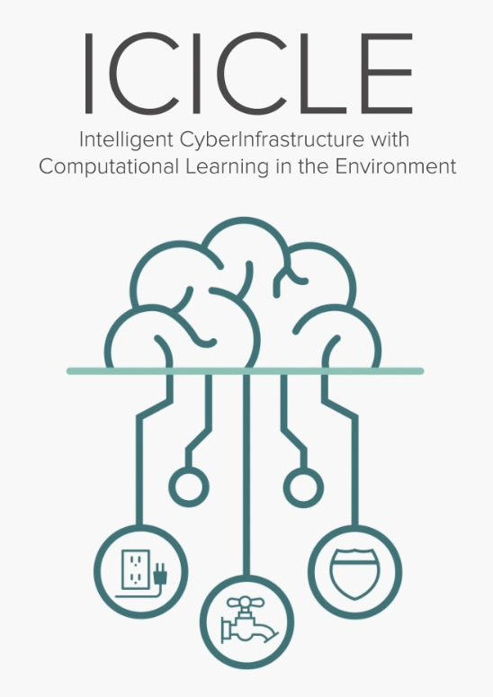


Agriculture and Supercomputing:
Overview of the NSF-AI Institute ICICLE
Follow us
@icicleai
BoF Presentation@ISC’25
by
http://icicle.ai
Dhabaleswar K. (DK) Panda
The Ohio State University
E-mail: panda@cse.ohio-state.edu
http://www.cse.ohio-state.edu/~panda
Notes:
Welcome to the BOF on AI4CI4AI and CI4AI: Community Input for ICICLE, the National Cyberinfrastructure for AI. We have an excellent panel of experts to describe the mission of ICICLE, the recently awarded NSF AI Research Institute.
My name is Vipin Chaudhary and I am the Kevin J Kranzusch Professor and Chair of Computer and Data Science at Case Western Reserve University and I will moderate the BOF. In the panel are Professor DK Panda, University Distinguished Scholar of Computer Science and Engineering at The Ohio State University; Professor Beth Plale, the Michael A. and Laurie Burns McRobbie Bicentennial Professor of Computer Engineering and Executive Director of the IU Pervasive Technology Institute at Indiana University; and Professor Rudi Eigenmann, Professor in the Department of Electrical and Computer Engineering at University of Delaware.
ICICLE formally started on Nov 1 of this year, so we are within our first month. Please visit the website, icicle.ai for details as we start ramping up our activities.
Please use the chat in zoom to write your questions, comments, etc. and we will answer and discuss those after the brief presentation.
To get things started, let me start with a short video to motivate the creation of ICICLE.

Slide 2
Computing has been evolving over the last three decades with multiple phases:
Phase 1 (1975-): Scientific Computing/HPC
Phase 2 (2000-): HPC + Big Data Analytics
Phase 3: (2010-): HPC + AI (Machine Learning/Deep Learning)

Slide 3


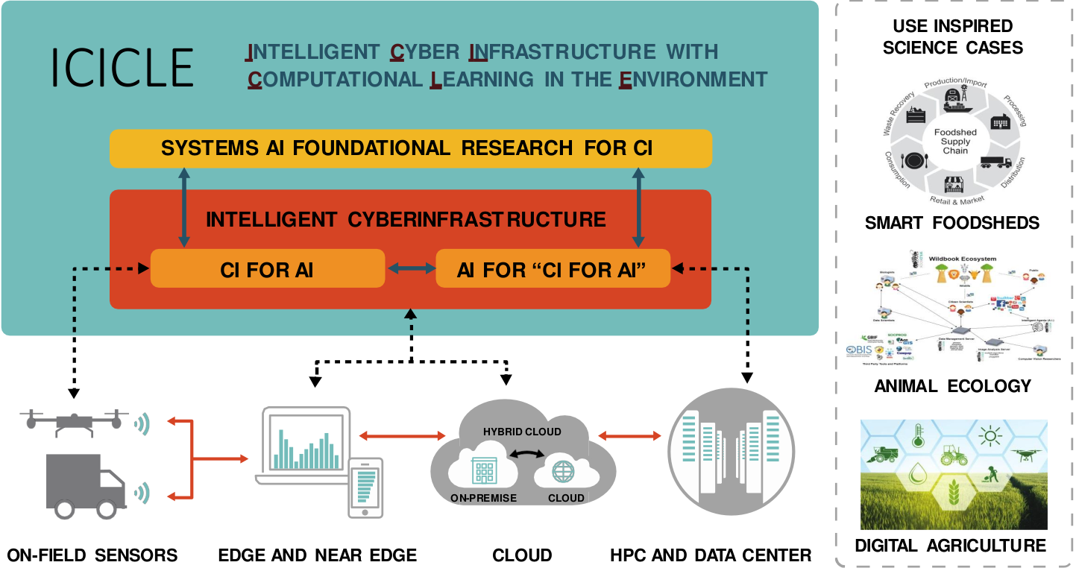
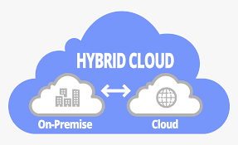
Emergence of the Computing Continuum
Computing Continuum
2. Big Data & Data Science
2. Big Data & Data Science
1. Scientific Computing
1. Scientific Computing
3. Artificial Intelligence
3. Artificial Intelligence
Edge & Near Edge
Clouds
On Field Sensors
HPC Systems & Data Centers
HPC Systems & Data Centers

Slide 4
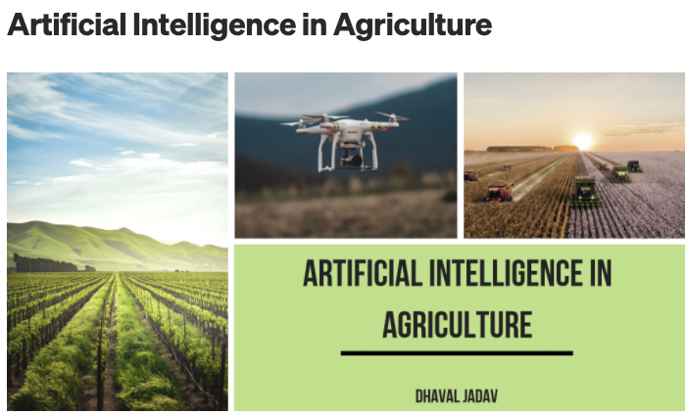
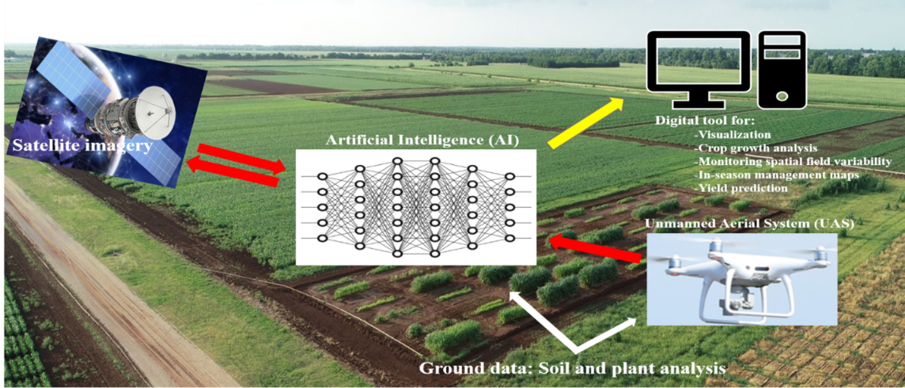
AI-Driven Digital Agriculture
https://medium.datadriveninvestor.com/artificial-intelligence-in-agriculture-62f71f8f6ae6
https://ccag.tamu.edu/research-project/digital-agriculture/

Slide 5
Data Movement and Control in Computing Continuum
Emerging Computing Continuum
On Field Sensors
Edge & Near Edge
Clouds
HPC Systems & Data Centers
Data Movement and Control
Notes:
Health and Medicine
Agriculture and Environment
Communications and Collaboration
Mobility, Machines and Manufacturing
AI for Social Good

Slide 6
How to Create Intelligent Cyberinfrastructure for Computing Continuum in the Modern AI Era
& Democratizing AI?
Follow us
@icicleai
http://icicle.ai
One of the 27 NSF-AI Institutes (each one $20M USD over 5 years)
ICICLE is the only one focusing on Intelligent Cyberinfrastructure
Notes:
Welcome to the BOF on AI4CI4AI and CI4AI: Community Input for ICICLE, the National Cyberinfrastructure for AI. We have an excellent panel of experts to describe the mission of ICICLE, the recently awarded NSF AI Research Institute.
My name is Vipin Chaudhary and I am the Kevin J Kranzusch Professor and Chair of Computer and Data Science at Case Western Reserve University and I will moderate the BOF. In the panel are Professor DK Panda, University Distinguished Scholar of Computer Science and Engineering at The Ohio State University; Professor Beth Plale, the Michael A. and Laurie Burns McRobbie Bicentennial Professor of Computer Engineering and Executive Director of the IU Pervasive Technology Institute at Indiana University; and Professor Rudi Eigenmann, Professor in the Department of Electrical and Computer Engineering at University of Delaware.
ICICLE formally started on Nov 1 of this year, so we are within our first month. Please visit the website, icicle.ai for details as we start ramping up our activities.
Please use the chat in zoom to write your questions, comments, etc. and we will answer and discuss those after the brief presentation.
To get things started, let me start with a short video to motivate the creation of ICICLE.

Slide 7
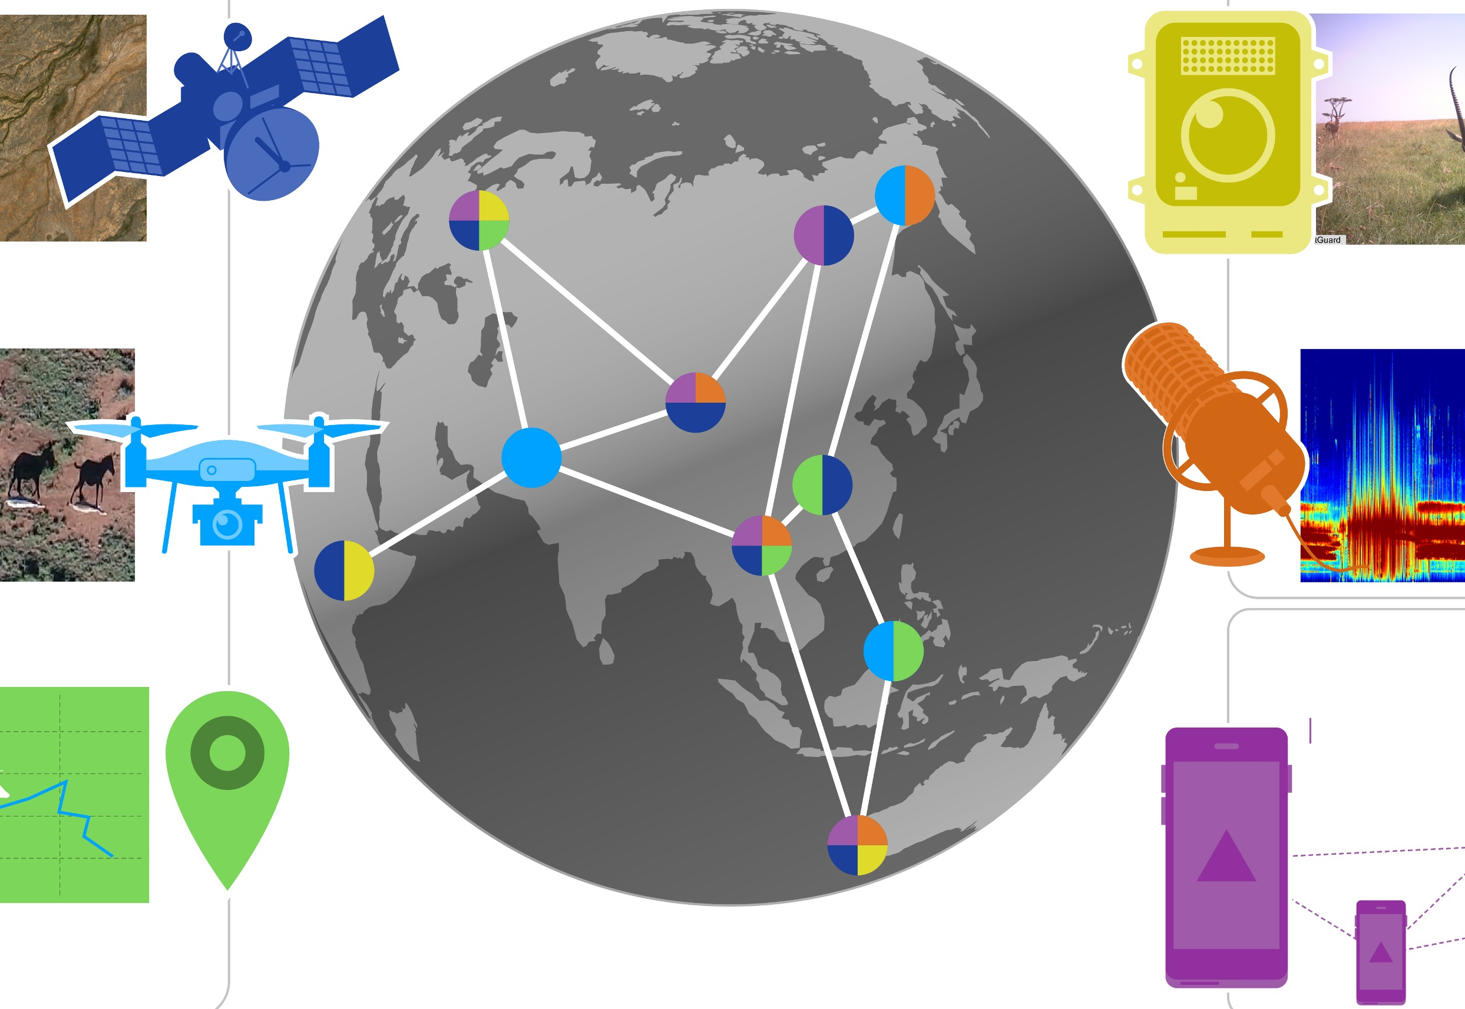
Objectives: Intelligent CyberInfrastructure for Computing Continuum
Use Inspired Science Domains
Digital
Agriculture
Smart
Foodsheds
Animal Ecology
ICICLE: Intelligent CyberInfrastructure with Computational Learning in the Environment
Systems AI Foundational Research for CI
Intelligent Cyber Infrastructure
CI for AI
AI for “CI for AI”
On Field Sensors
Edge & Near Edge
Clouds
HPC Systems & Data Centers
Emerging Computing Continuum
Notes:
Health and Medicine
Agriculture and Environment
Communications and Collaboration
Mobility, Machines and Manufacturing
AI for Social Good

Slide 8
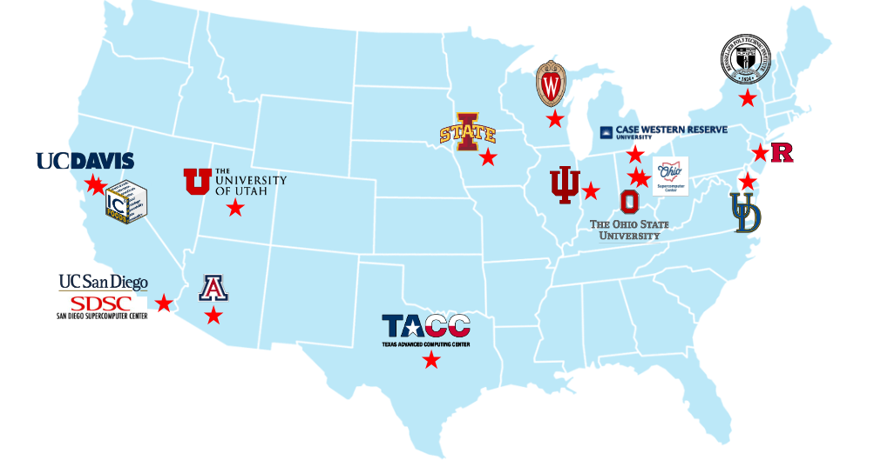





















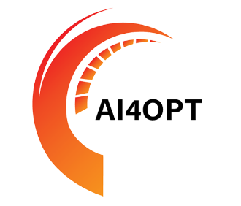







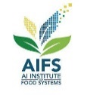


Participation (Current):
16 Organizations, 30 faculty, 26 staff, (44 PhD, 10 MS, 13 undergrad, 3 K-12) students & many Collaborators
Govt. Agencies & National Labs
International
Industry
Research Institutes
NSF & USDA Funded AI Institutes
Hospitals & Universities
Notes:
ICICLE has 13 participating institutes with 46 investigators. These are spread all over the US geographically and has many other collaborators including international institutions, industry, other AI institutes, national labs, and research institutes.

Slide 9
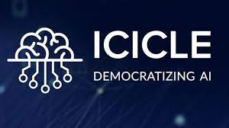




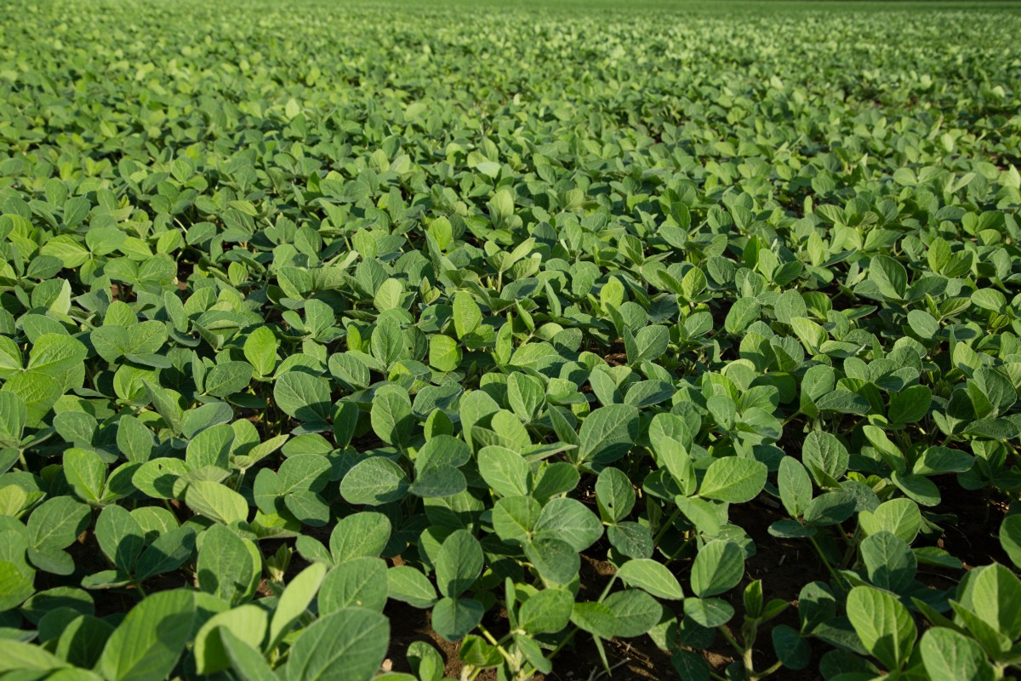
Collaboration: ICICLE and the Technology Innovation Hub (TIH) at the Indian Institute of Technology Bombay (IIT-B), India
Digital Agriculture
Crop Health Modeling
Aerial Crop Scouting
- Sense crop health and level context to predict crop yield
- Detect stressors and diseases for geographically diverse crops
- Apply remedies with little human intervention via Internet of Things (IoT) and sensor systems
- CI for fully autonomous aerial systems
- Simplify deployment of UAV in real fields to capture common crop health conditions
- Provide accurate maps that yield valuable insights for crop management
This research collaboration will contribute novel design paradigms for context-adaptive CI and aims to develop next-generation CI for Digital Agriculture including AI and machine learning methods targeting 3 core areas.
Privacy-Preserving Data Exchange
Create secure, trustworthy, and privacy-preserving platforms that connect farmers and allow them to share information and resources safely.
Building upon the existing ICICLE infrastructure, CI and AI capabilities, researchers will leverage contextual conditions in India for Digital Agriculture that differ from the United States to (1) expose brittle CI components, (2) make AI4CI more robust and expansive in the long-term, (3) devise principles that yield context-aware CI

Slide 10
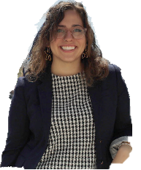
Research Plan: Overall Vision
FOUNDATIONAL SYSTEMS AI
ICICLE
INTELLIGENT CYBERINFRASTRUCTURE
SOFTWARE ARCHITECTURE AND DESIGN
CO-DESIGN FOR USE INSPIRED SCIENCE
CI FOR AI
AI FOR CI-FOR-AI
Intelligent CI
VISUAL ANALYTICS FOR CI AND AI EXPLAINABILITY
PRIVACY, ACCOUNT ABILITY AND DATA INTEGRITY

Slide 11
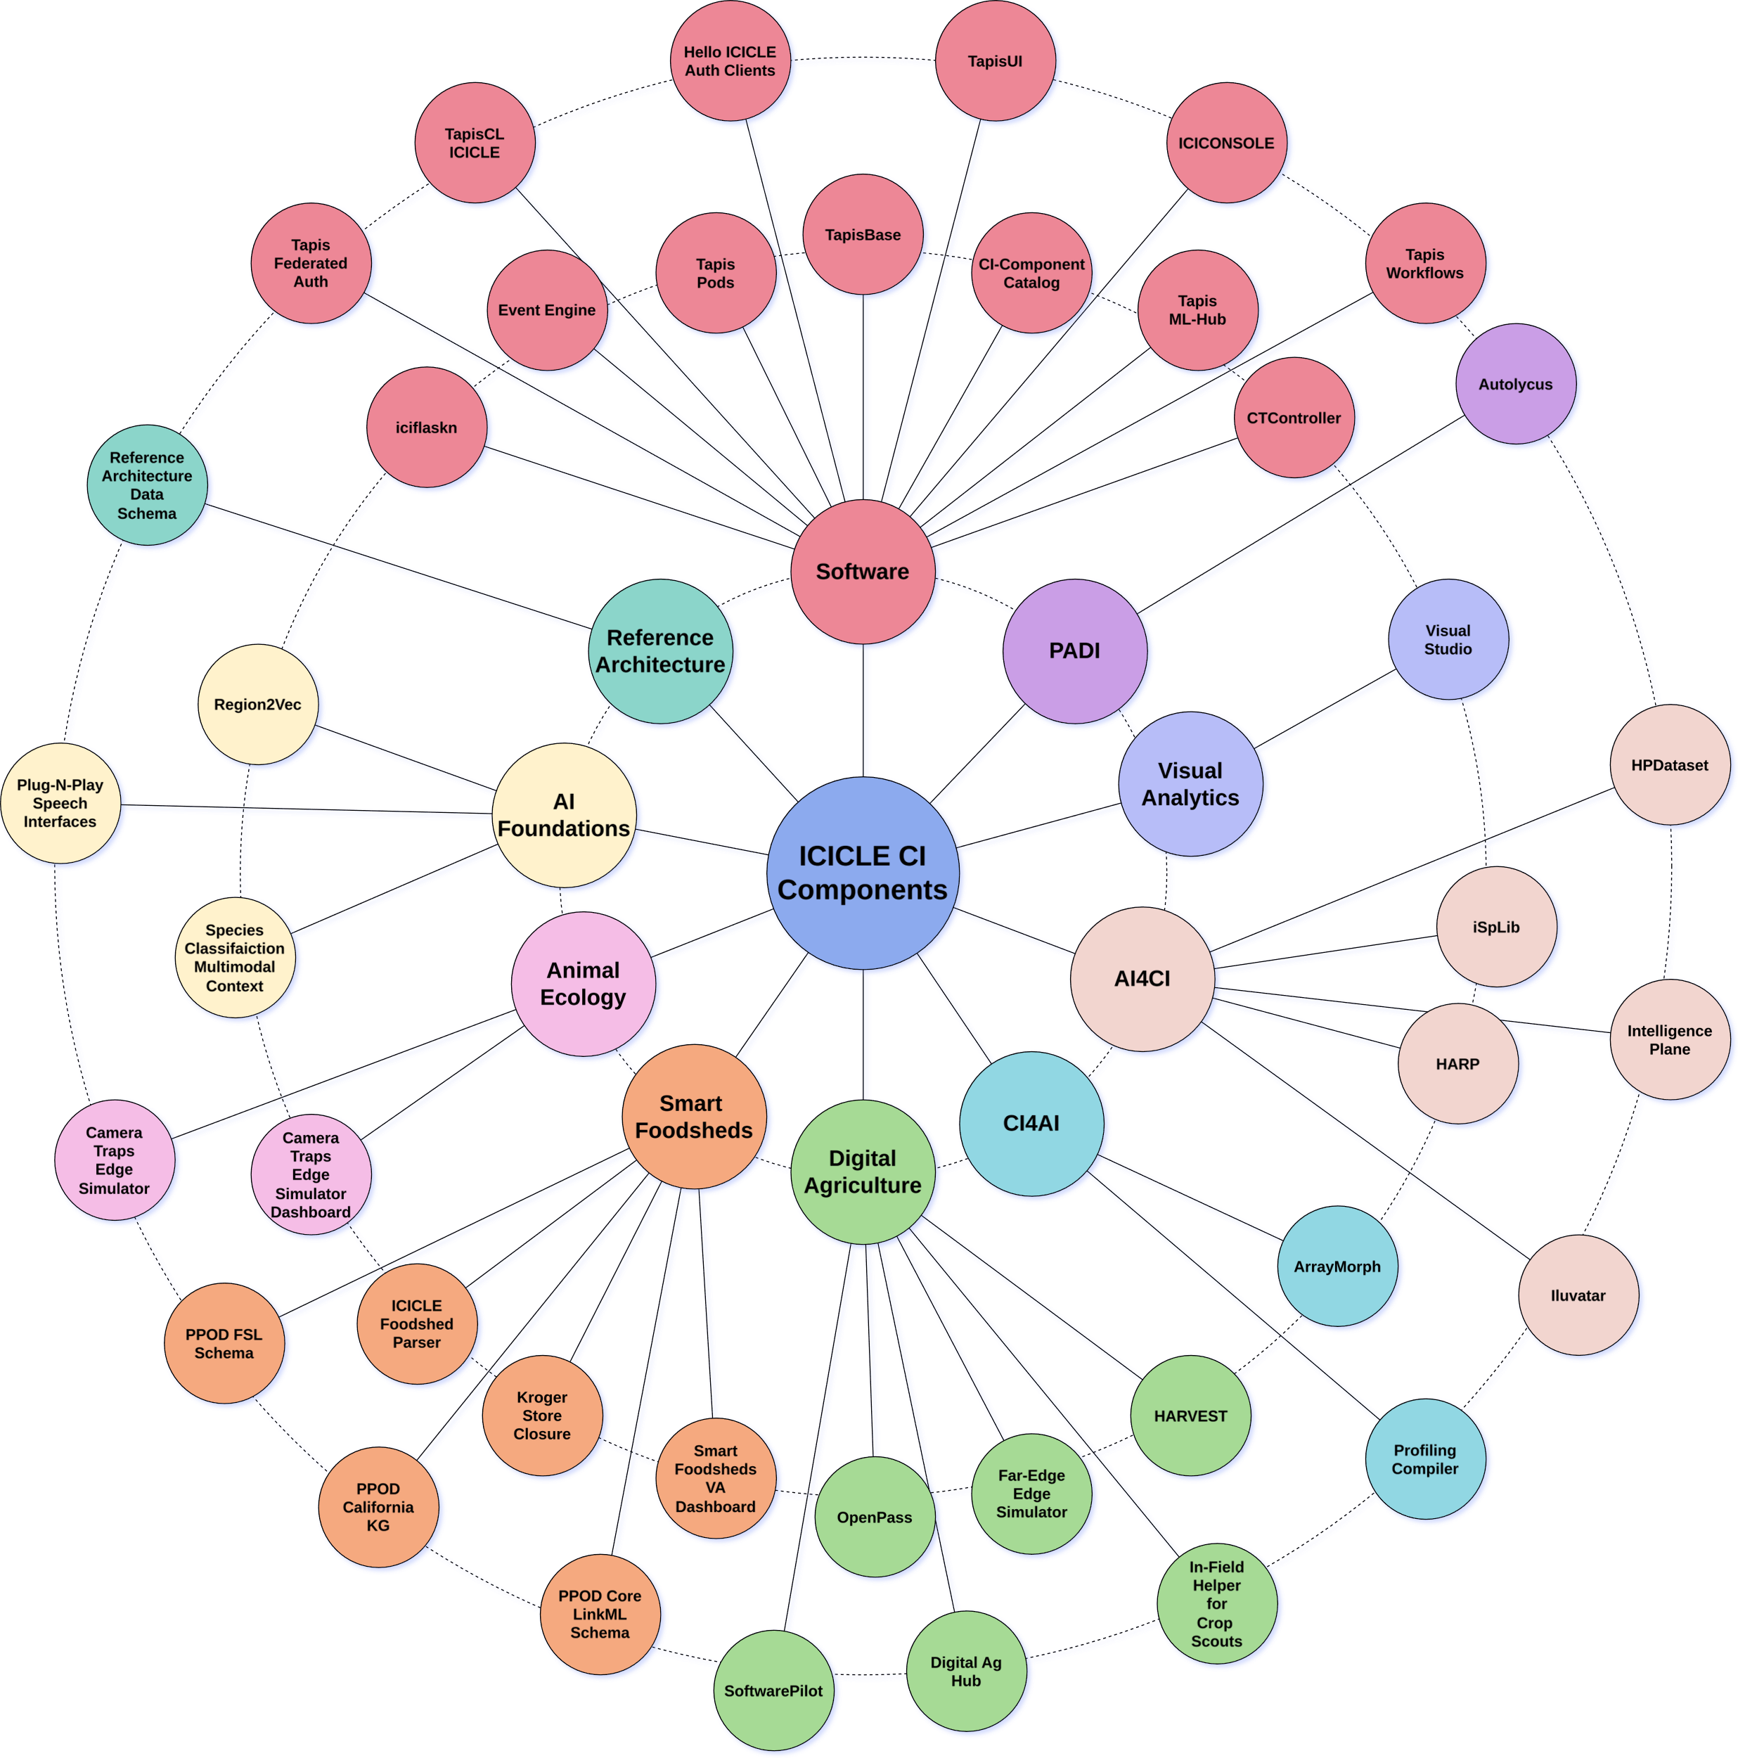
CI/SOFTWARE Components released across
Thrusts and Use-Inspired Science
Metrics
Total Clones:
  2,034
Total Views:
  10,340
4 PyPI Packages
1,038 Container Downloads
825K total authentications to ICICLE Tapis tenant
37 unique ICICLE Tapis users
https://icicle.osu.edu/cyberinfrastructure/software

Slide 12
Goal: Towards Designing End-to-end Digital Agriculture CI Solutions and make these available as Services for various Stakeholders
Crop Health Issues
HPC-Enabled Data Harvesting & Preparation
HPC for Ag AI
From HPC to the field: Computing Continuum
Crop Management Interventions
Use-Inspired Cyberinfrastructure
End-to-end software workflows that democratize
access, use, and benefits of AI-driven digital agriculture

Slide 13
Challenges: Overview and Solutions
Data Collection
Data Labeling
Distributed Training with Semi-Supervised Learning
Quantization on Edge Devices
Aerial Crop Scouting
End-to-end CI

Slide 14
Overview of ICICLE Workflow for Digital Agriculture
Model Selection
Modular &
Configurable
Hyperparameters Selection
Data Labeling
Inference Execution
Data Selection and Class Definition
Plug-and-Play
HPC Training
Model Retrieval
Display Markers on Map
Data Geotagging and Rotation
Model/metadata saving
Inference Data Preprocessing
Display Training Statistics
Individual Sample Analysis
Display Statistics Dashboard
Data Transfer from Drone to Edge
Plot Tiles Extraction
Data Collection via Drone
Data Collection via Drone
Show Heatmap
A1
A2
A3
A4
B1
B2
B3
B4
B5
B6
B7
C1
C2
C3
C4
D1
D2
D3
D4
Data Collection and Preprocessing
Model Training
Inference
Visualization
Timeline

Slide 15
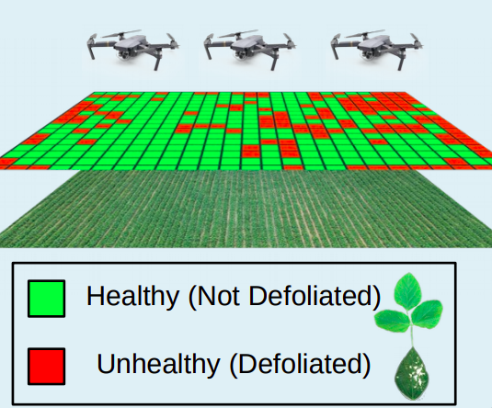
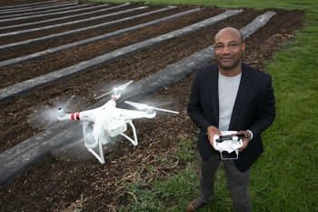
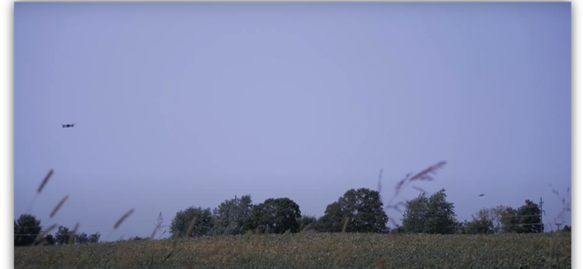
Digital Agriculture: Aerial Crop Scouting
Aerial Crop Scouting: In this workload, we seek to create heat maps that describe crop health for a field
  Inform self-driving tractors and sprayers to reduce the application of pesticide and fertilizer
  Predict crop yields for harvest and market timing
  Identify trends across farms, such as the introduction of resistant weeds
Technology: Unmanned aerial vehicles (UAV) capture high resolution images
  Flying low (15 ft above ground): 1 pixel -> mm
Transformative: At mm-granularity, stakeholders can detect biological phenomena invisible to satellites
  Soybean leaf defoliation caused by Japanese beetle
Software Pilot (https://pypi.org/project/SoftwarePilot/)
OpenPass (http://149.165.155.188:2298/)
Courtesy of LaRue
Farms Inc.

Slide 16
Demo: ICICLE Digital Agriculture Pipeline
Available from YouTube
https://www.youtube.com/watch?v=Jqf_XexN8Fg

Slide 17
Collaboration: AI and Other Institutes
MOU with the AI4Opt Institute (Michelle and Alfonso)
  Optimize food logistics for the USDA-LFPA collaboration, including the Tribal Elder Food Box program collaboration, in Wisconsin for summer 2023
  MOU with AI4Opt: Creating the Food Access Simulation and Strategy ABM
NSF HDR DIRSE Imageomics Institute partnership in research, education, DEI (Tanya and Chuck)
MOU with USDA AI Institute for Resilient Agriculture (AIIRA) at Iowa State University of Science & technology
  Collaboration to develop end-to-end training solutions that are deployable on high-performance computing resources to accelerate the training of open-source ag foundational models.
Academic Agreement signed with ISU – Includes ARA work with ICICLE. ICICLE participation at ARA Fest'24 (August 24)
Scheduled Seminar Series with Ag AID & AI Farms to explore future collaboration. Scope of work being defined (MOU).
Potential collaboration discussions (on-going):
  Indian Institute of Technology, Bhubaneswar, India
  AI-Edge Hub, UK (under the Center-to-Center Initiative by UKRI)
  Agrifood Innovation Institute, Australian National University, Australia
Looking forward to more collaboration!!

Slide 18
An Expanded Presentation of ICICLE-DA
Session on “Achieving High-Performance on ML Applications”
1:00-2:00 pm today
Hall Z, 3rd floor
Chaired by Olga Pearce

Slide 19
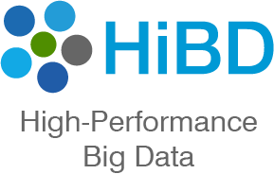
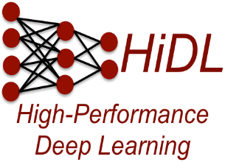

Thank You!
panda@cse.ohio-state.edu
Network Based Computing
Laboratory
Network-Based Computing Laboratory
http://nowlab.cse.ohio-state.edu/
The High-Performance MPI/PGAS Project
http://mvapich.cse.ohio-state.edu/
The High-Performance Big Data Project
http://hibd.cse.ohio-state.edu/
The High-Performance Deep Learning Project
http://hidl.cse.ohio-state.edu/

