Slide 1
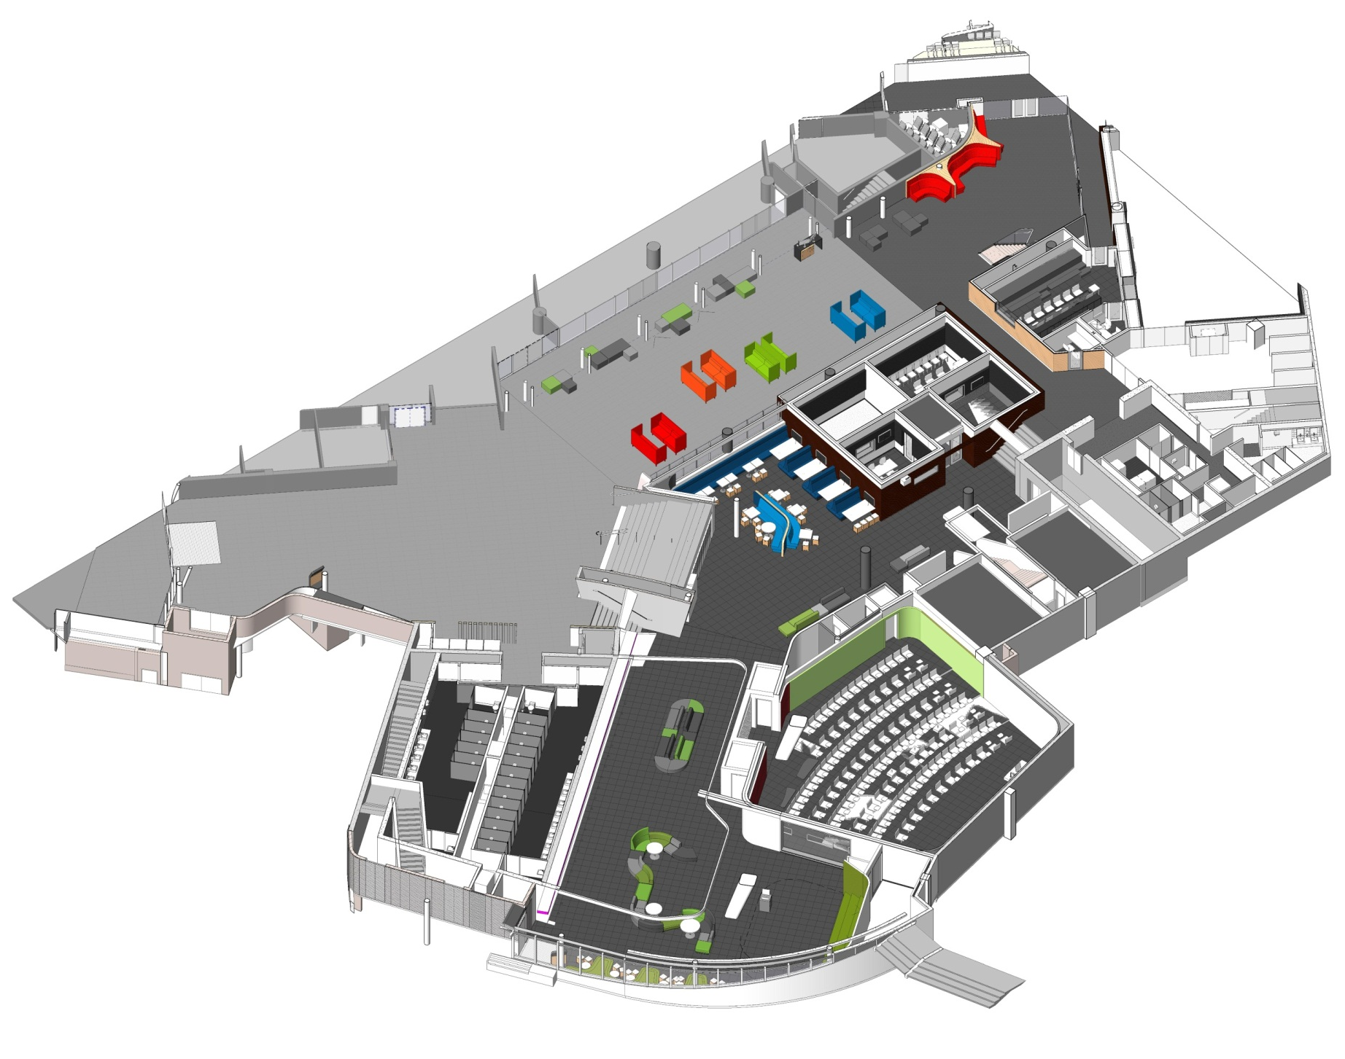

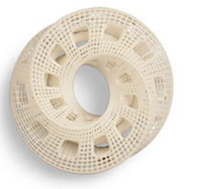


LEVEL 1 & 2
Living wall
To WA Atrium
WG201
Entry from
Wellesley Street
WG126
Exhibition space
WG1268/9
Presentation space
Entry from
Mayoral drive

Slide 2
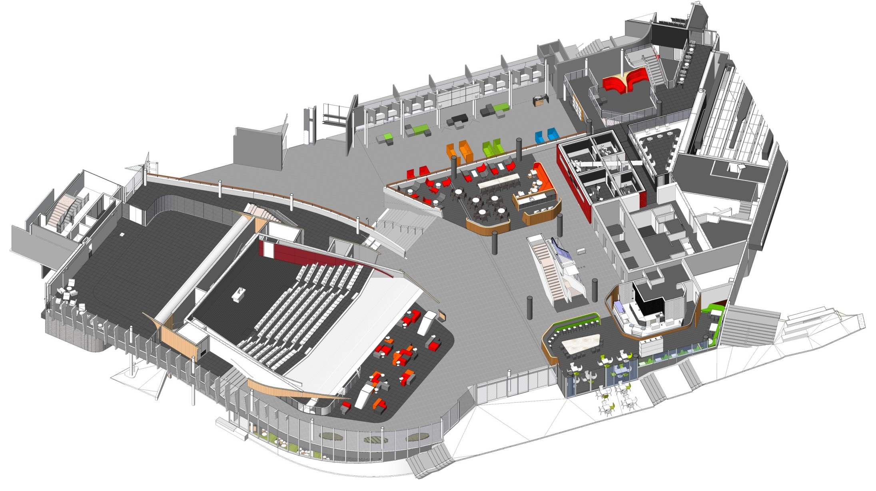
LEVEL 3
Entry from
Wellesley Street
WG201
WG308
Te Iringa
WG403
WG306
Newsfeed cafe
Entry from Governor Fitzroy opposite WF Business building

Slide 3
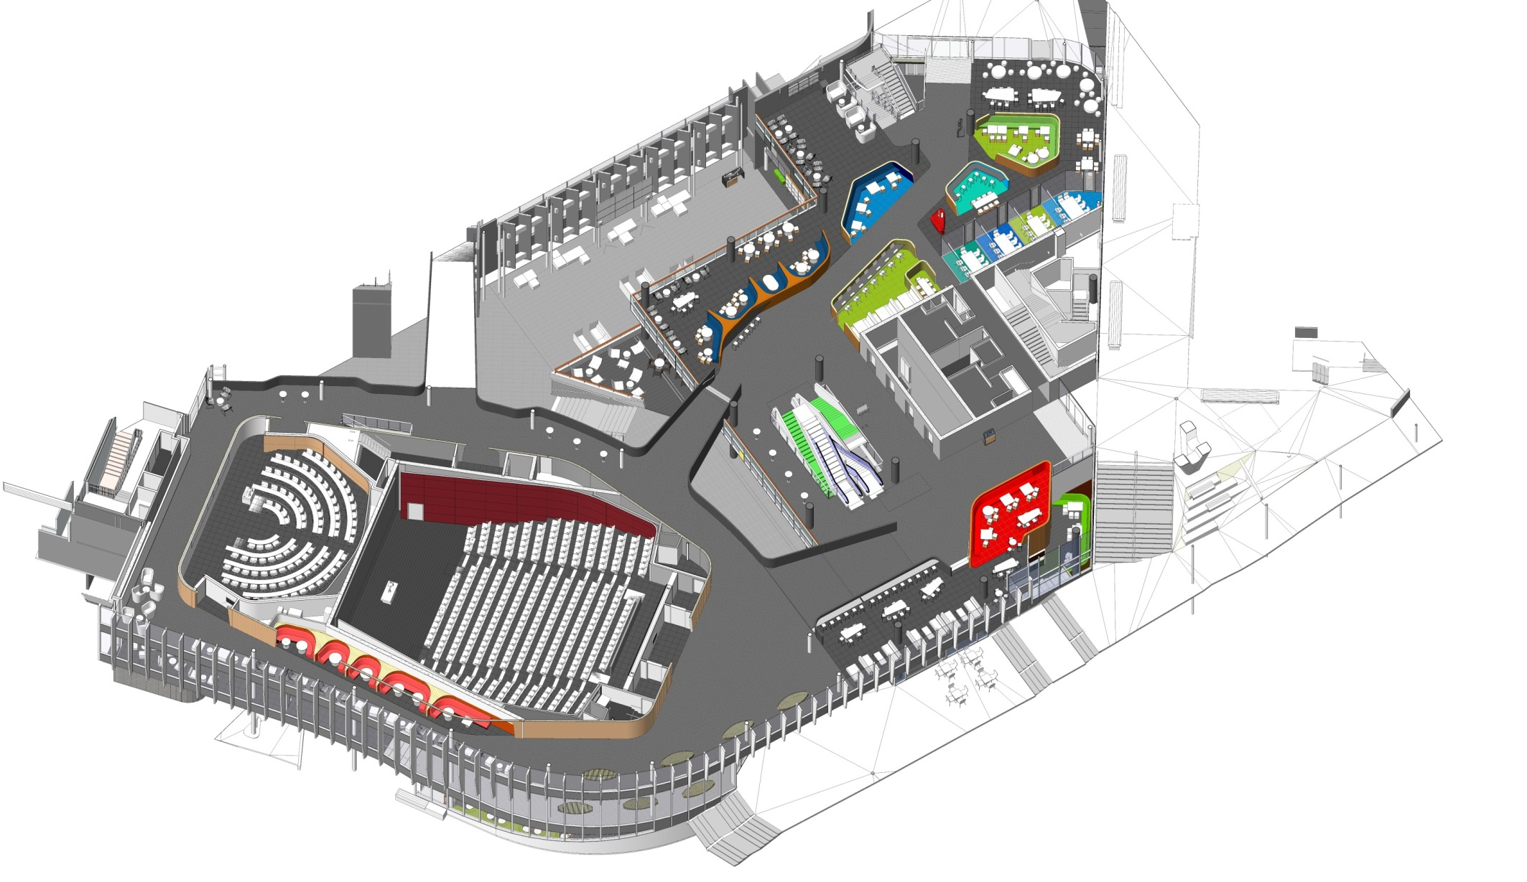
LEVEL 4
WG201
Entry from upper Governor Fitzroy place and St Pauls Street to level 4
WG404
WG403
‘Tree House’

